Slide 1

Interface Segregation Principle (ISP)
Dr. Siobhán Drohan (sdrohan@wit.ie)
Eamonn de Leastar (edeleastar@wit.ie)
Produced
by:
Department of Computing and Mathematics
http://www.wit.ie/

Slide 2
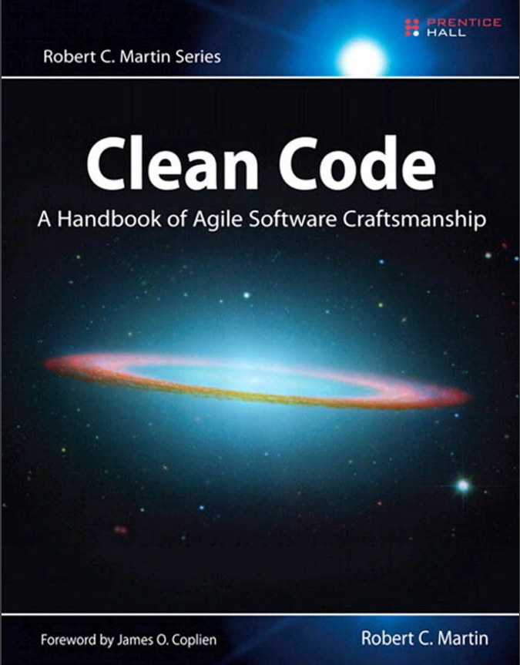
SOLID Class Design Principles
In this talk, we will refer to the SOLID principles examples in this book and also this website.
SOLID → five principles for object-oriented class design i.e.
best guidelines for building a maintainable object-oriented system.

Slide 3
SOLID Class Design Principles
S Single Responsibility Principle (SRP). Classes should have one, and only one, reason to change. Keep your classes small and single-purposed.
O Open-Closed Principle (OCP). Design classes to be open for extension but closed for modification; you should be able to extend a class without modifying it. Minimize the need to make changes to existing classes.
L Liskov Substitution Principle (LSP). Subtypes should be substitutable for their base types. From a client’s perspective, override methods shouldn’t break functionality.
I Interface Segregation Principle (ISP). Clients should not be forced to depend on methods they don’t use. Split a larger interface into a number of smaller interfaces.
D Dependency Inversion Principle (DIP). High-level modules should not depend on low-level modules; both should depend on abstractions. Abstractions should not depend on details; details should depend on abstractions.

Slide 4
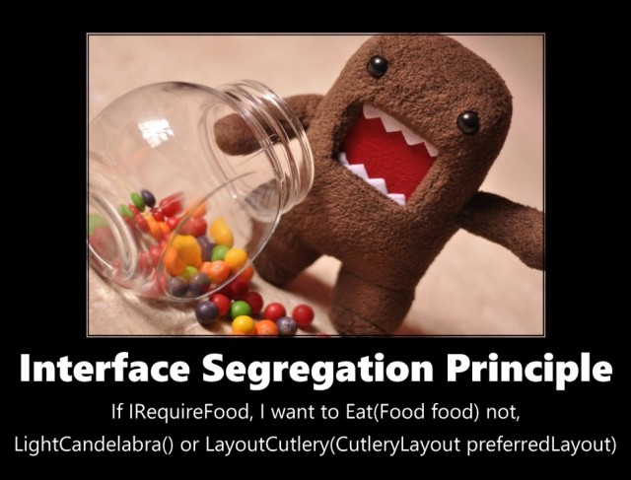
https://zeroturnaround.com/rebellabs/object-oriented-design-principles-and-the-5-ways-of-creating-solid-applications/

Slide 5
Interface Segregation Principle (ISP) – Basic Principle
“Don’t depend
on things
you don’t
need”
https://zeroturnaround.com/rebellabs/object-oriented-design-principles-and-the-5-ways-of-creating-solid-applications/

Slide 6
Interface Segregation Principle (ISP) – Basic Principle
Clients should not be forced to depend upon interface members they do not use.
Instead, create multiple,
smaller, cohesive interfaces.
https://zeroturnaround.com/rebellabs/object-oriented-design-principles-and-the-5-ways-of-creating-solid-applications/

Slide 7
Interface Segregation Principle (ISP) – Basic Principle
Clients should not be forced to depend upon interface members they do not use.
Instead, create multiple,
smaller, cohesive interfaces.
Smaller interfaces are easier to implement → improves flexibility and the possibility of reuse.
https://zeroturnaround.com/rebellabs/object-oriented-design-principles-and-the-5-ways-of-creating-solid-applications/

Slide 8
Example 1 - A Basic ATM

Slide 9
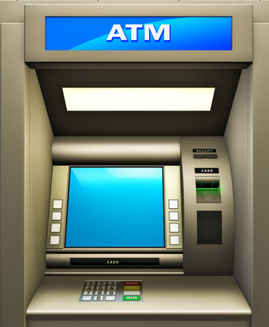
ISP – Example 1 – A Basic ATM
Picture an ATM machine which has a screen where we wish to display different messages.
Assume that messages can be displayed at different times during an ATM transaction e.g.
Login
Withdrawal
Deposit
etc.
https://zeroturnaround.com/rebellabs/object-oriented-design-principles-and-the-5-ways-of-creating-solid-applications/
Notes:
Image source: http://www.naijaonlinebiz.com/15-top-uses-of-automated-teller-machine-atm/

Slide 10
ISP – Example 1 – A Basic ATM
Possible Interface Solution:
public interface Messenger {
void askForCard();
void tellInvalidCard();
void askForPin();
void tellInvalidPin();
void tellCardWasSiezed();
void askForAccount();
void tellNotEnoughMoneyInAccount();
void tellAmountDeposited();
void tellBalance();
}
https://zeroturnaround.com/rebellabs/object-oriented-design-principles-and-the-5-ways-of-creating-solid-applications/
Notes:
Image source: http://www.naijaonlinebiz.com/15-top-uses-of-automated-teller-machine-atm/

Slide 11
ISP – Example 1 – A Basic ATM
Fat Interface
Possible Interface Solution:
public interface Messenger {
void askForCard();
void tellInvalidCard();
void askForPin();
void tellInvalidPin();
void tellCardWasSiezed();
void askForAccount();
void tellNotEnoughMoneyInAccount();
void tellAmountDeposited();
void tellBalance();
}
https://zeroturnaround.com/rebellabs/object-oriented-design-principles-and-the-5-ways-of-creating-solid-applications/
Notes:
Image source: http://www.naijaonlinebiz.com/15-top-uses-of-automated-teller-machine-atm/

Slide 12
ISP – Example 1 – A Basic ATM
BUT…we have grouped unrelated functionality together…yes, they are all messages, but they occur at different times during an ATM transaction.
public interface Messenger {
void askForCard();
void tellInvalidCard();
void askForPin();
void tellInvalidPin();
void tellCardWasSiezed();
void askForAccount();
void tellNotEnoughMoneyInAccount();
void tellAmountDeposited();
void tellBalance();
}
https://zeroturnaround.com/rebellabs/object-oriented-design-principles-and-the-5-ways-of-creating-solid-applications/
Notes:
Image source: http://www.naijaonlinebiz.com/15-top-uses-of-automated-teller-machine-atm/

Slide 13
ISP – Example 1 – A Basic ATM
BUT…we have grouped unrelated functionality together…yes, they are all messages, but they occur at different times during an ATM transaction.
public interface Messenger {
void askForCard();
void tellInvalidCard();
void askForPin();
void tellInvalidPin();
void tellCardWasSiezed();
void askForAccount();
void tellNotEnoughMoneyInAccount();
void tellAmountDeposited();
void tellBalance();
}
e.g. login Messages
https://zeroturnaround.com/rebellabs/object-oriented-design-principles-and-the-5-ways-of-creating-solid-applications/
Notes:
Image source: http://www.naijaonlinebiz.com/15-top-uses-of-automated-teller-machine-atm/

Slide 14
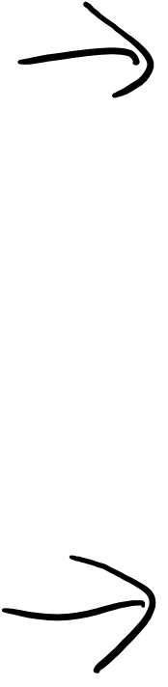
ISP – Example 1 – A Basic ATM
Refactoring the Interfaces (1st pass)…
public interface Messenger {
void tellCardWasSiezed();
void askForAccount();
void tellNotEnoughMoneyInAccount();
void tellAmountDeposited();
void tellBalance();
}
public interface LoginMessenger {
void askForCard();
void tellInvalidCard();
void askForPin();
void tellInvalidPin();
}
https://zeroturnaround.com/rebellabs/object-oriented-design-principles-and-the-5-ways-of-creating-solid-applications/
Notes:
Image source: http://www.naijaonlinebiz.com/15-top-uses-of-automated-teller-machine-atm/

Slide 15
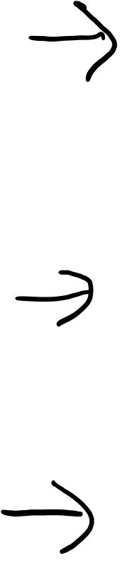
ISP – Example 1 – A Basic ATM
Refactoring the Interfaces (2nd pass)…
public interface AccountMessenger {
void askForAccount();
void tellNotEnoughMoneyInAccount();
void tellAmountDeposited();
void tellBalance();
}
public interface ErrorMessenger {
void tellCardWasSiezed();
}
public interface LoginMessenger {
void askForCard();
void tellInvalidCard();
void askForPin();
void tellInvalidPin();
}
https://zeroturnaround.com/rebellabs/object-oriented-design-principles-and-the-5-ways-of-creating-solid-applications/
Notes:
Image source: http://www.naijaonlinebiz.com/15-top-uses-of-automated-teller-machine-atm/

Slide 16

ISP – Example 1 – A Basic ATM
Refactoring the Interfaces (3rd pass)…
public interface AccountMessenger {
void askForAccount();
void tellBalance();
}
public interface DepositMessenger {
void tellAmountDeposited();
}
public interface WithdrawalMessenger {
void tellNotEnoughMoneyInAccount();
}
public interface LoginMessenger {
void askForCard();
void tellInvalidCard();
void askForPin();
void tellInvalidPin();
}
public interface ErrorMessenger {
void tellCardWasSiezed();
}
https://zeroturnaround.com/rebellabs/object-oriented-design-principles-and-the-5-ways-of-creating-solid-applications/
Notes:
Image source: http://www.naijaonlinebiz.com/15-top-uses-of-automated-teller-machine-atm/

Slide 17
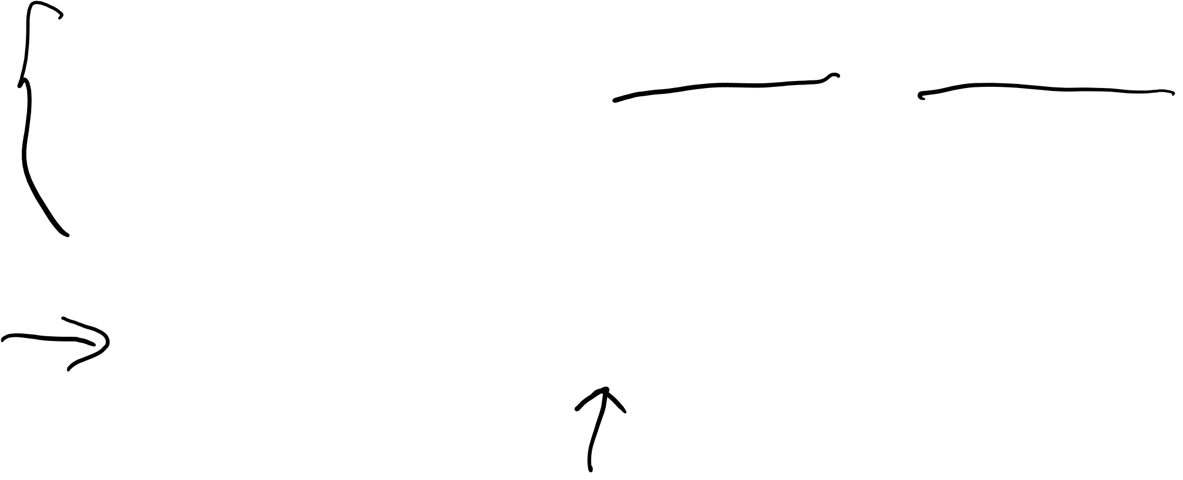
ISP – Example 1 – A Basic ATM
Using the Interfaces…
Just choose which interface(s) are appropriate for the implementing class!
Having refactored our interfaces, we are not forced to provide implementations for methods that we don’t need.
public class Messenger implements LoginMessenger, WithdrawalMessenger
{
//concrete implementations of the methods listed in the interfaces above.
}
public interface LoginMessenger {
void askForCard();
void tellInvalidCard();
void askForPin();
void tellInvalidPin();
}
public interface WithdrawalMessenger {
void tellNotEnoughMoneyInAccount();
}
https://zeroturnaround.com/rebellabs/object-oriented-design-principles-and-the-5-ways-of-creating-solid-applications/
Notes:
Image source: http://www.naijaonlinebiz.com/15-top-uses-of-automated-teller-machine-atm/

Slide 18
Example 2 - An Advanced ATM

Slide 19
ISP – Example 2 – An Advanced ATM
We now want ATM output to be:
Printed on a variety of devices i.e. screen, braille tablet & speech synthesizer.

Slide 20
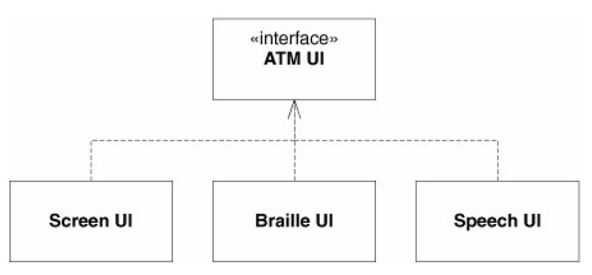
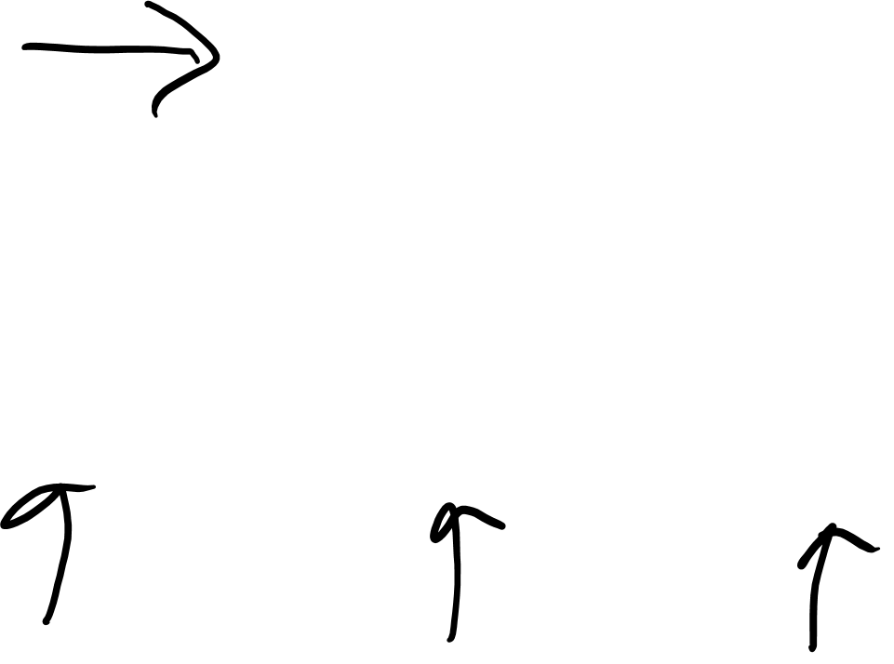
ISP – Example 2 – An Advanced ATM
We now want ATM output to be:
Printed on a variety of devices i.e. screen, braille tablet & speech synthesizer.

Slide 21
ISP – Example 2 – An Advanced ATM
Consider also that all ATM transactions are concrete implementations of the abstract Transaction class.

Slide 22
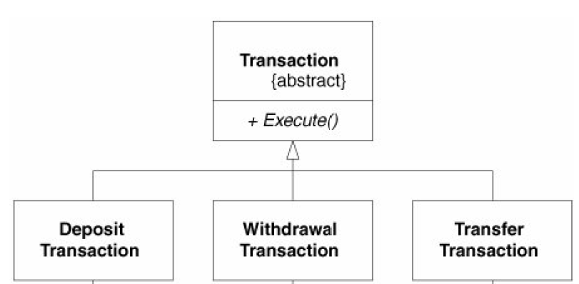
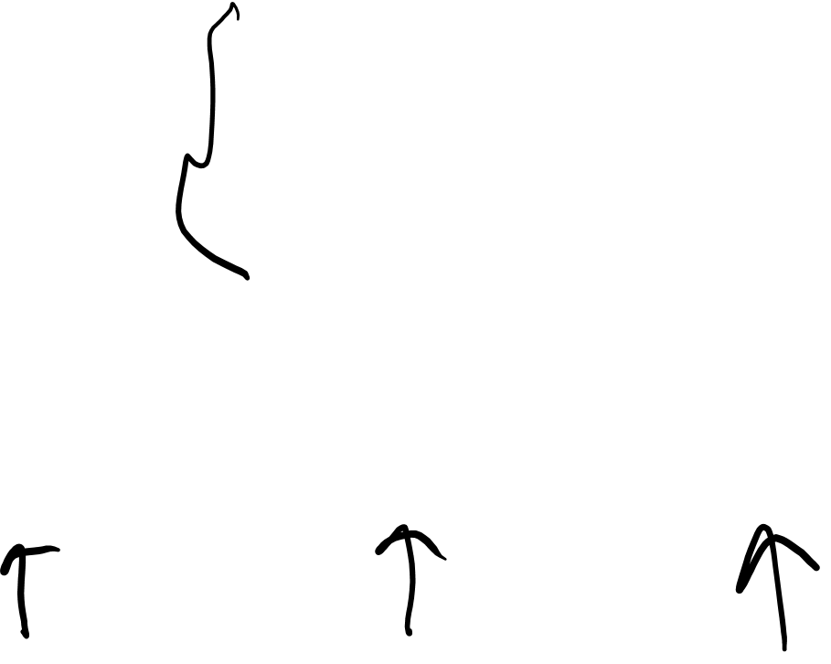
ISP – Example 2 – An Advanced ATM
Consider also that all ATM transactions are concrete implementations of the abstract Transaction class.

Slide 23
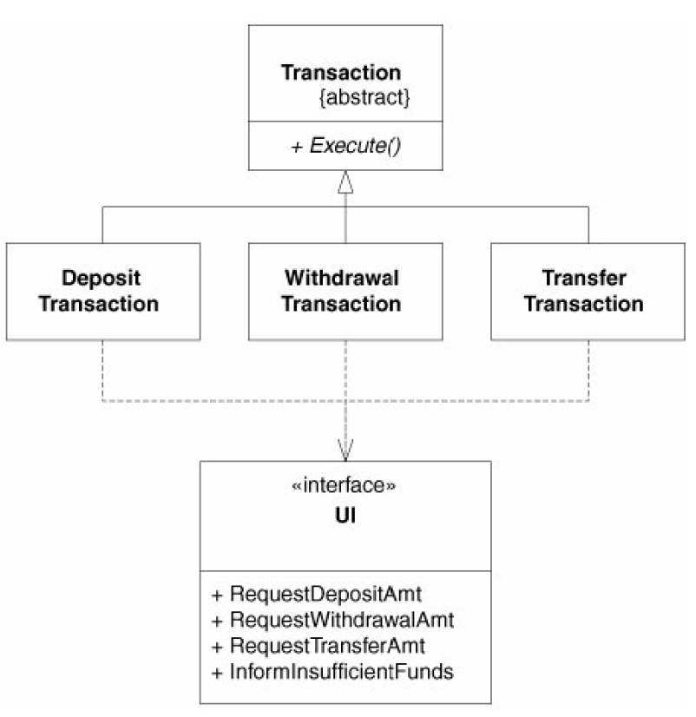
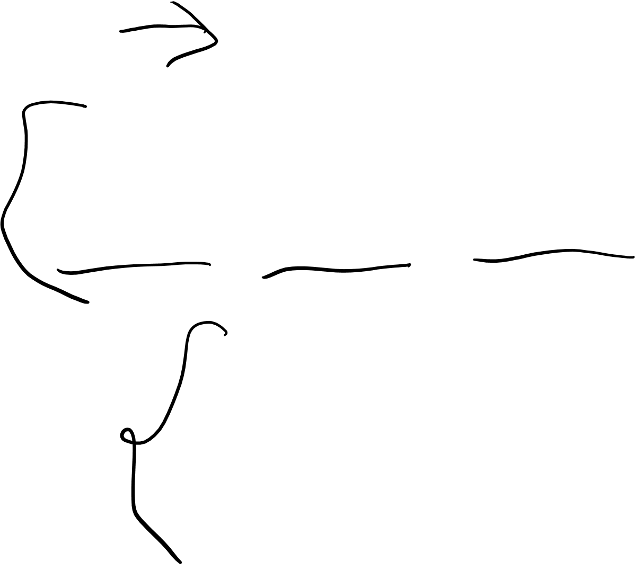
ISP – Example 2 – An Advanced ATM
Assume now that each concrete transaction class invokes UI methods.
For example:
In order to ask the user to enter the amount to be deposited, the DepositTransaction object invokes the RequestDepositAmount method of the UI class.

Slide 24
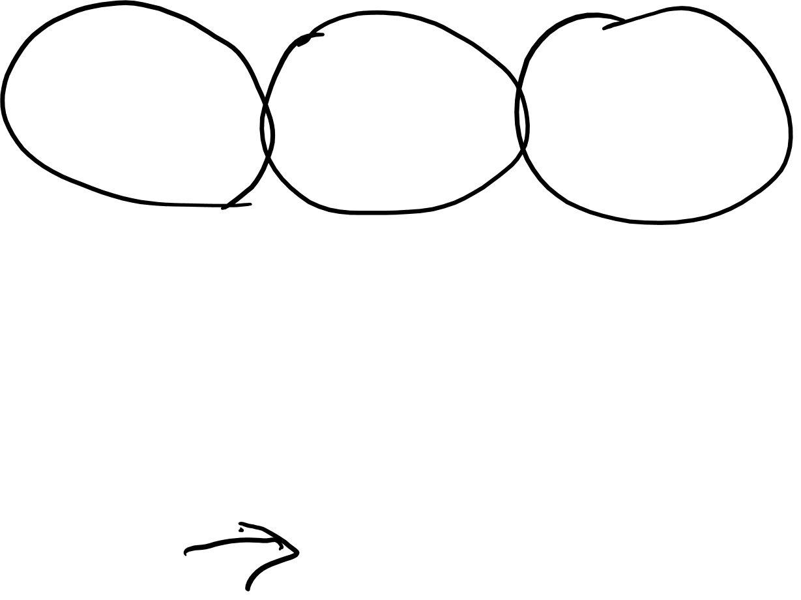
ISP – Example 2 – An Advanced ATM
Now consider that we need a new transaction, say, PayGasBillTransaction.
We would need to add new methods to the UI interface to deal with messages associated with the new transaction.
See any problems???

Slide 25
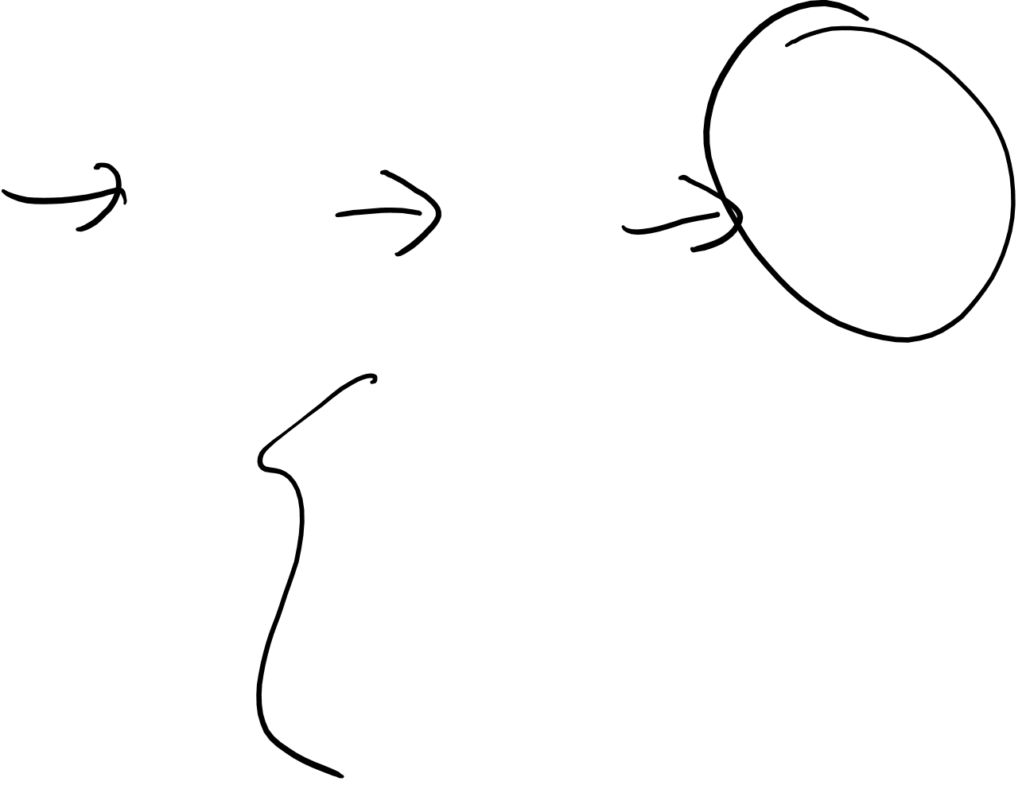
ISP – Example 2 – An Advanced ATM
Problem:
Since DepositTransaction, WithdrawalTransaction, and TransferTransaction all use the same UI interface, we are going to have to rebuild them, with code for the new methods.
If any of these transactions are components in other systems, we would have to redeploy, etc.

Slide 26
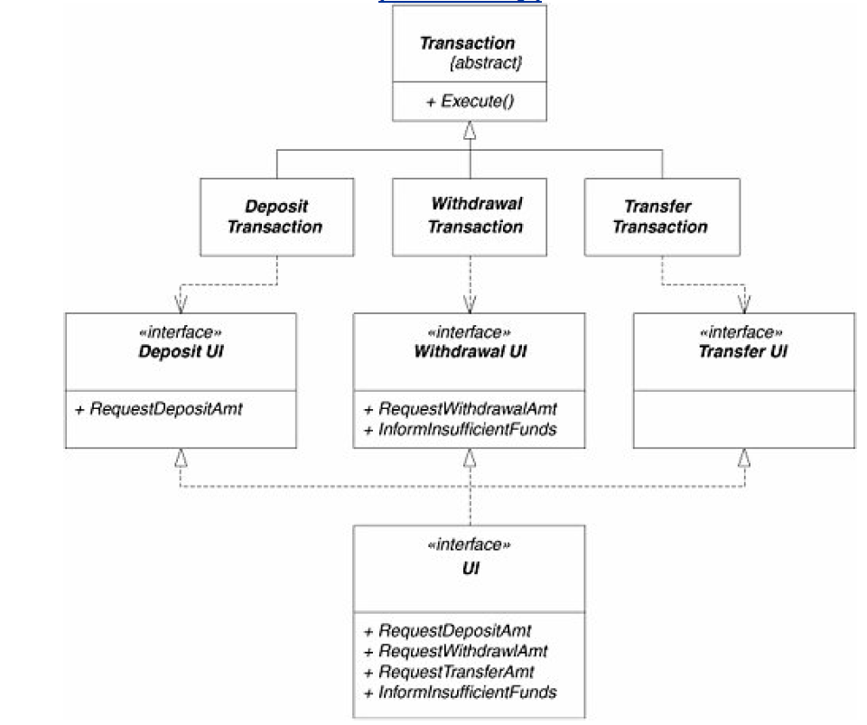

ISP – Example 2 – An Advanced ATM
Solution:
We can avoid this unfortunate scenario by segregating the UI interface into multiple interfaces.
These separate interfaces can then be multiply inherited into the final UI interface.

Slide 27
Interface Segregation Principle (ISP) - Recap
Clients should not be forced to depend upon interface members they do not use.

Slide 28
Interface Segregation Principle (ISP) - Recap
Clients should not be forced to depend upon interface members they do not use.
Interfaces that are not cohesive are “fat”.
ISP does not like "fat" interfaces.
Break up “fat” interfaces into groups of cohesive methods.

